Slide 1

Decreasing the workload for overloaded teachers with automated short answer response grading
Ian McNair
Northeastern Illinois University
December 3rd, 2020

Slide 2

Agenda
The Question
The Answer
The Process
The Data
The Features
The Model
The Application
The Performance
The Future

Slide 3

Introduction
Grading is not fun and repetitive.
Tasks which are not fun and repetitive should be automated.
Notes:
Where did this idea come from
I was grading, hated it
Just finished the data mining course
Discuss your own experience as a teacher and your journey.

Slide 4

Can short answer response questions be autograded?
The Question

Slide 5
Yes
The Answer
Notes:
Start moving towards what has been done in the pass

Slide 6
Automated Short Answer Grading Timeline
Concept Mapping
Detecting the presence of concepts in both student and teacher answers
Information Extraction
Searching student answer for certain concepts or patterns
Corpus Based Methods
Utilizing larger documents to compare student answers to
Machine Learning
Utilizing NLP techniques to create features and generate some type of score via a model
Evaluation
Method agnostic, about utilizing a standard dataset and crowdsourcing a problem (Kaggle)
Notes:
FIRST – What is a short answer response???
SECOND Timeline
THIRD below
Discuss clustering and its application at Microsoft research
Discussing my own thoughts on machine learning and its accessibility.
Why isn’t it utilized even more in education? There’s no money in it.
There are companies now starting to develop around using ML to impact education which I am excited about
When thinking about this project, wanted to create a minimum viable product
Didn’t think I should try to create some crazy new model. Could I create something basic, that worked? If it did, it would be….
Should be easy to use
Should be as automated as possible
Should be free
Project focus, what area am I trying to address?

Slide 7
Project Focus
Grounded in reality
What kind of dataset would a teacher have?
What would it look like?
Requires minimal effort from teacher
Set it and forget it
Addressing a narrow, specific area
One sentence-long short responses
Prediction is correct or incorrect

Slide 8
Project Considerations
Each question set is small
Each question set needs its own unique set of features which relates student answer to “ground truth”
Each question set needs it own model
Some of the question sets are extremely imbalanced (e.g. 100 observations, 2 correct answers)
The minimum viable product should make a teacher’s grading workload shrink!

Slide 9
The Process

Slide 10
Timeline
Research
Read a handful of papers to get my bearing. Looked at how ASAG has been done throughout the years.
Data
Found a dataset that used real world science questions. Cleaned and processed it into many forms including ordering and stemming.
Feature Engineering
Created three categories of features, sentence stats, similarity metrics, and n-gram flags.
Modeling and Validation
Modelled with supervised, unsupervised, and a combination method that’s technically unsupervised.
Application
Created an application for people to explore my project as well as teachers to use my models.
Notes:
Pretty standard timeline, nothing crazy here

Slide 11
The Data

Slide 12
Raw Data
 | Student Answer | Teacher Answer | Label | Question ID
0 | Because they are repelling each other always. | Like poles repel and opposite poles attract. | 0 | 0
1 | The magnets are not touching because they cannot attract to each other if they are north to north or south to south. | Like poles repel and opposite poles attract. | 1 | 0
2 | The magnets will maybe not stick because the force of the magnets will maybe the pencil is long and the magnets cannot feel the other magnets. | Like poles repel and opposite poles attract. | 0 | 0

Slide 13
Processed Data
 | Student Answer | Stopwords Removed | Stemmed | Stemmed & Ordered
0 | Because they are repelling each other always. | repelling | repel | repel
1 | The magnets are not touching because they cannot attract to each other if they are north to north or south to south. | magnets touching attract north north south south | magnet touch attract north north south south | attract magnet north north south south touch
2 | The magnets will maybe not stick because the force of the magnets will maybe the pencil is long and the magnets cannot feel the other magnets. | magnets maybe stick force magnets maybe pencil long magnets feel magnets | magnet mayb stick forc magnet mayb pencil long magnet feel magnet | feel forc long magnet magnet magnet magnet mayb mayb pencil stick
Notes:
Why I didn’t do more?
I did, but early one when I thought this project would only utilize clustering, I was trying to optimize my scores for clustering/

Slide 14
The features

Slide 15
Feature types
Sentence Statistics
Similarity Measures
N-gram / Bag-of-words
Numeric values based on sentence structure.
e.g. Number of words, number of commas, number of nouns, number of verbs etc.
Measures of document vector similarity.
Always compares student to teacher answer
e.g. Jaccard, Cosine
Flags which indicate of the presence of a sequence of words.
e.g. unigram, bigram, trigram flags.
Notes:
There are many more!

Slide 16
The Models

Slide 17
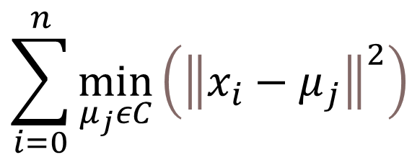
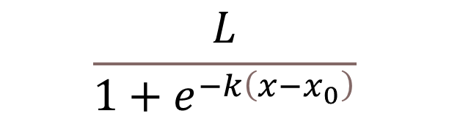
Model Types
K-Means Clustering
Logistic Regression
Unsupervised
Centroids randomly initiated, converge on groups of clusters by minimizing the within-cluster sum-of-squares metric
Supervised
Requires a training set to initialize/train the parameters of the logistic function, which
$$\begin{aligned}&\sum_{i=0}^{n}{\min_{μ_{j}εC}\left({\left\|x_{i}−μ_{j}\right\|}^{2}\right)} \end{aligned}$$
$$\frac{L}{1+e^{−k\left(x−x_{0}\right)}}$$
Notes:
Logistic -- Where L is the curves maximum value, k is the growth rate, x0 is the midpoint of the curve, and x are the values of the domain

Slide 18
The Application

Slide 19
The performance

Slide 20
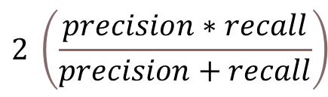
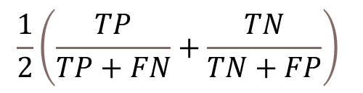
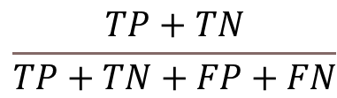
Metric Types
Accuracy
Adjusted Balanced Accuracy
F1 Score
Fairly standard metric that is a good metric when the data is balanced.
Intuitively, how well the model predicts across a dataset.
Like accuracy, but gives equal weighting to the minority class
Intuitively, a score of 0 means random chance whereas 1 means perfect performance.
Harmonic mean between recall and precision.
Balances how well the model predicts the positive class with how often it wrongly predicts the positive class.
$$\frac{TP+TN}{TP+TN+FP+FN}$$
$$\frac{1}{2}\left(\frac{TP}{TP+FN}+\frac{TN}{TN+FP}\right)$$
$$2 \left(\frac{precision∗recall}{precision+recall}\right)$$

Slide 21
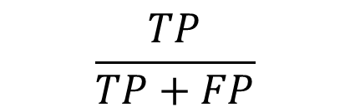

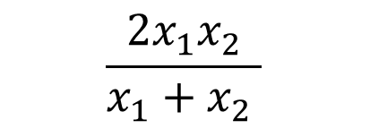
F1 Score Deep Dive
Harmonic Mean
Recall
Precision
Used in many situations involving rates and ratios.
Example: Find the average speed of a car that travels at 20mph a distance d and 60 mph back that same distance.
The ability of the classifier to find all the positive samples.
The ability of the classifier not to label as positive a sample that is negative
$$\frac{2x_{1}x_{2}}{x_{1}+x_{2} }$$
$$\frac{TP}{TP+FN }$$
$$\frac{TP}{TP+FP}$$

Slide 22
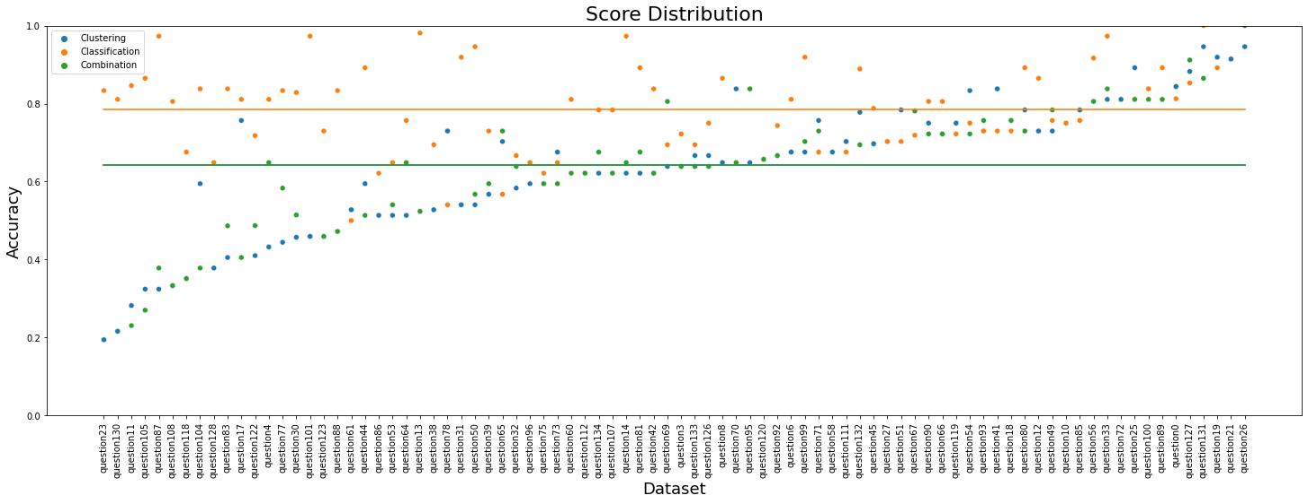
Accuracy

Slide 23
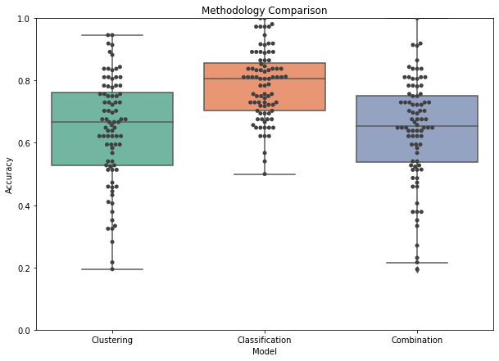
Accuracy
Method | mean Accuracy Score | MEdian Accuracy Score
Clustering | 0.642 | 0.667
Classification | 0.785 | 0.806
Combination | 0.641 | 0.653

Slide 24
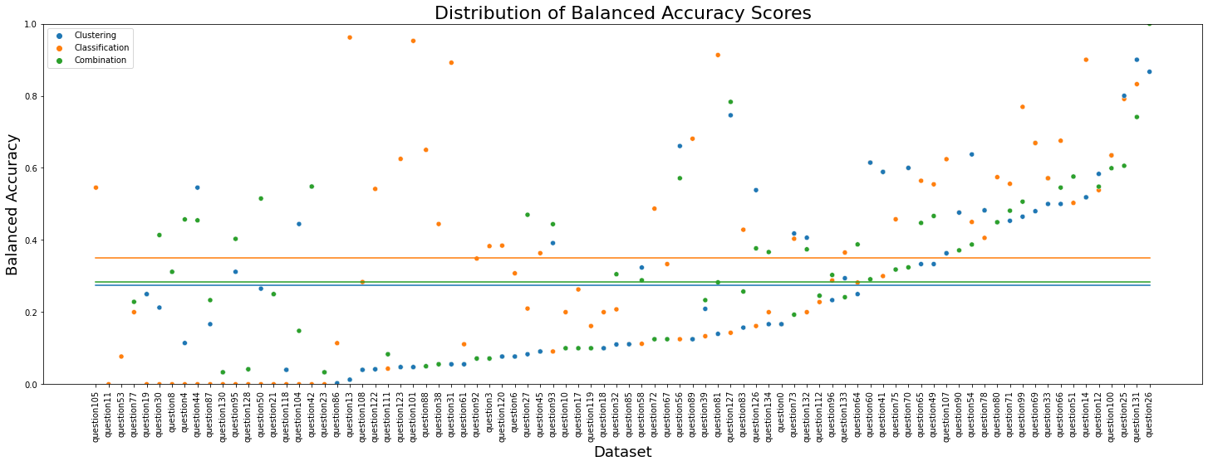
Balanced Accuracy

Slide 25
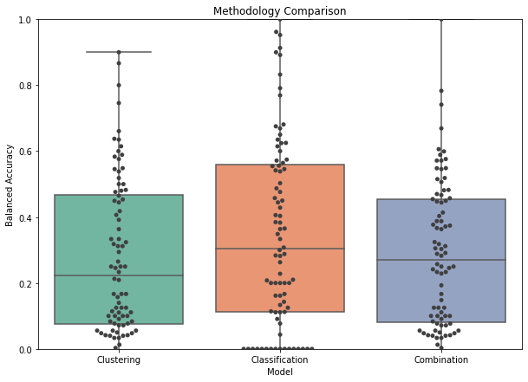
Balanced Accuracy
Method | mean Balanced Accuracy Score | Median Balanced accuracy score
Clustering | 0.274 | 0.223
Classification | 0.350 | 0.304
Combination | 0.284 | 0.270

Slide 26
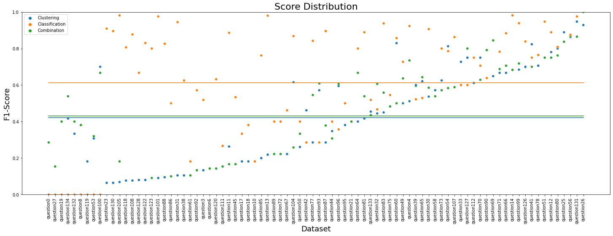
F1 Score

Slide 27
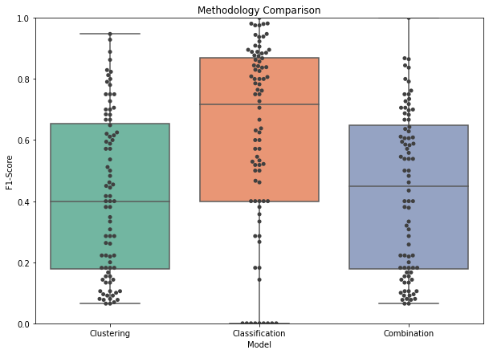
F1 Score
Method | mean F1-Score | Median F1-Score
Clustering | 0.421 | 0.4
Classification | 0.614 | 0.717
Combination | 0.430 | 0.448

Slide 28
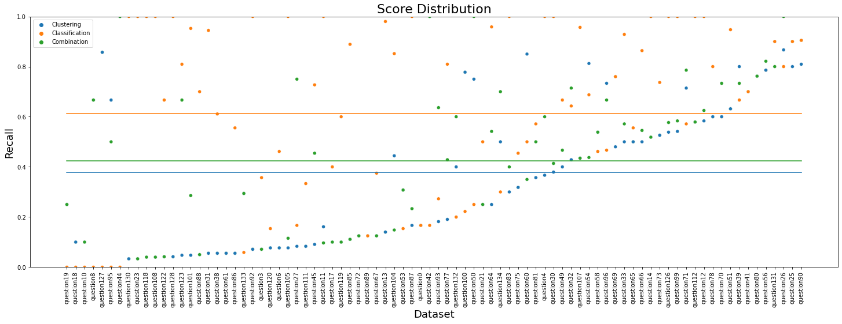
Recall

Slide 29
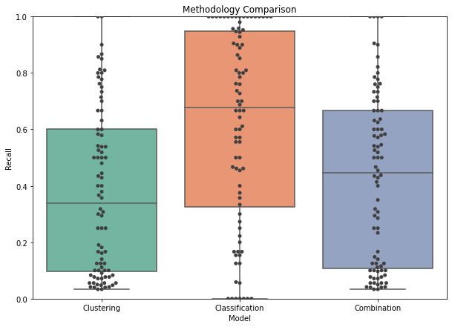
Recall
Method | mean Recall Score | Mean Recall Score
Clustering | 0.377 | 0.337
Classification | 0.613 | 0.677
Combination | 0.424 | 0.446

Slide 30
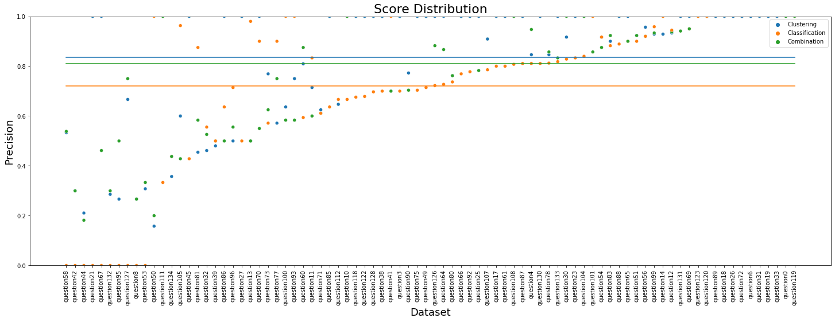
Precision

Slide 31
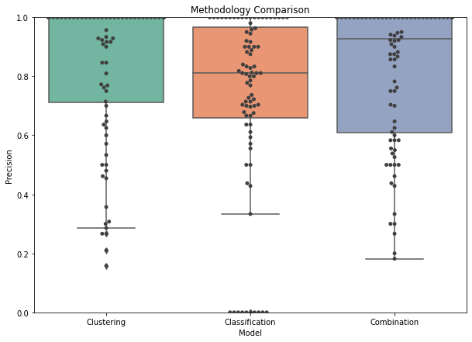
Precision
Method | Mean Precision Score | median Precision Score
Clustering | 0.835 | 1
Classification | 0.722 | 0.811
Combination | 0.811 | 0.928

Slide 32


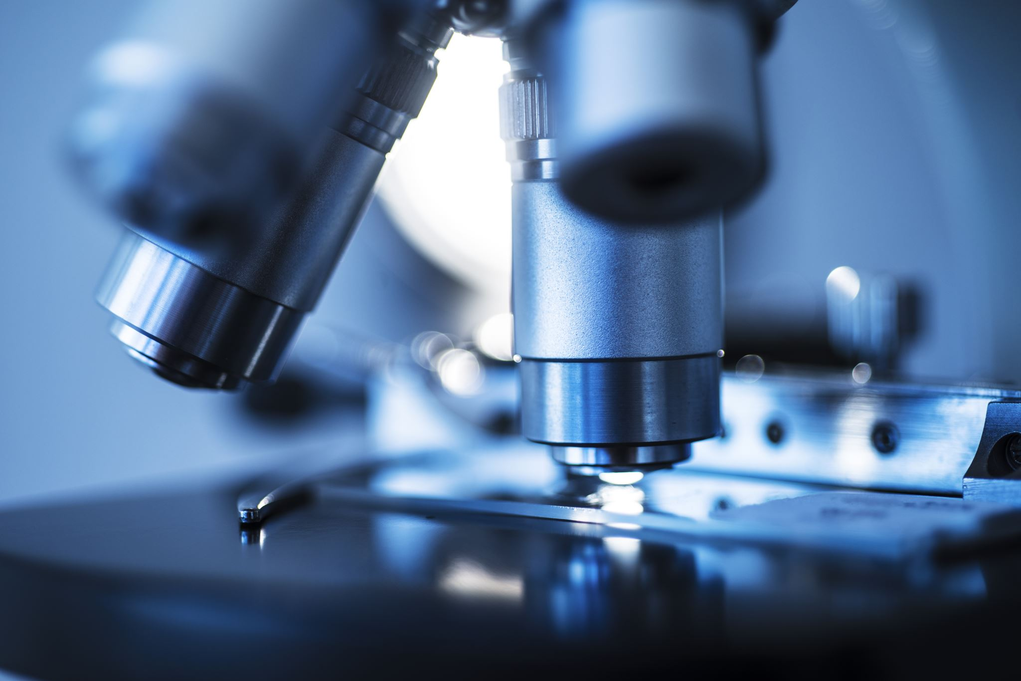
Metric Summary
Consistently, classification performs the best
The assumption that answers close to the teacher’s answer in feature space would be correct and those furthest away is not a good assumption to make, unless there are better features
The questions that can easily delineate between a correct and incorrect response were easier to autograde.
Questions where students answered all correctly or incorrectly posed a problem for all methods

Slide 33
The Future

Slide 34



Future Work
Feature space can be improved upon greatly. Using different sentence processing, metrics, and other creative methods could greatly increase the predictive power of even the simplest models
Better and more sophisticated models could be used e.g. Recurrent Neural Networks or Support Vector Machines

Slide 35




Thank you
Ian McNair
Northeastern Illinois University
Linkedin.com/ian-mcnair
Github.com/ian-mcnair

Slide 36
References
[1] Bird, S., Klein, E., & Loper, E. (2009). Natural language processing with Python: analyzing text with the na…tural language toolkit. " O&#x27;Reilly Media, Inc."
[2] Basu S., Jacobs, C., Vanderwende, L., “Powergrading: a Clustering Approach to Amplify Human Effort for Short Answer Grading”. Microsoft Research.
[3] Brooks, M., Basu S., Jacobs, C., Vanderwende, L., “Divide and Correct: Using Clusters to Grade Short Answers at Scale”. Microsoft Research.
[4] Callear, D., Jerrams-Smith, J., Soh, V. (2001). CAA of short non-MCQ answers. In M. Danson & C. Eabry (Eds.), Proceedings of the 5th computer assisted assessment conference (pp. 1–14). Loughborough: Loughborough University.
[5] G. Hinton and S. Roweis. “Stochastic Neighbor Embedding”. New York University.
[6] Gay, L.R. (1980). The comparative effects of multiple-choice versus short-answer tests on retention. Journal of Educational Measurement, 17(1), 45–50.
[7] Gonzalez-Barbone, V., & Llamas-Nistal, M. (2008). eAssessment of open questions: an educator’s perspective. In C. Traver, M. Ohland, J. Prey, T. Mitchell (Eds.), Proceedings of the 38th annual frontiers in education conference (pp. F2B–1–F2B–6). Saratoga Springs: IEEE.
[8] Hochreiter, Sepp & Schmidhuber, Jürgen. (1997). Long Short-term Memory. Neural computation. 9. 1735-80. 10.1162/neco.1997.9.8.1735.
[9] Honnibal, M., & Montani, I. (2017). spaCy 2: Natural language understanding with Bloom embeddings, convolutional neural networks and incremental parsing.
[10] Hou, W.J., Tsao, J.H., Li, S.Y., Chen, L. (2010). Automatic assessment of students’ free-text answers with support vector machines. In M. Ali, C. Fyfe, N. Garc ́ıa-Pedrajas, F. Herrera (Eds.), Proceedings of the 23rd international conference on industrial engineering and other applications of applied intelligent systems (Vol. 1, pp. 235–243). Cordoba: Springer.
[11] John A. Hartigan , Clustering Algorithms, John Wiley & Sons New York , London , Sydney , Toronto,1975 .
[12] Klein, R., Kyrilov, A., Tokman, M. (2011). Automated assessment of short free-text responses in computer science using latent semantic analysis. In G. R ̈oßling, T. Naps, C. Spannagel (Eds.), Proceedings of the 16th annual joint conference on innovation and technology in computer science education (pp. 158–162). Darmstadt: ACM.
[13] Ng, A., "Machine Learning and AI via Brain simulations". Stanford University.
[14] Pedregosa, F., Varoquaux, Ga"el, Gramfort, A., Michel, V., Thirion, B., Grisel, O., … others. (2011). Scikit-learn: Machine learning in Python. Journal of Machine Learning Research, 12(Oct), 2825–2830.
[15] P. Patil, A. Agrawal. “Auto Grader for Short Answer Questions”. Stanford University.
[16] Peng, Joanne & Lee, Kuk & Ingersoll, Gary. (2002). An Introduction to Logistic Regression and Reporting. Journal of Educational Research - J EDUC RES. 96. 3-14. 10.1080/00220670209598786.
[17] S. Burrows, I. Gurevych, B. Stein, The Eras and Trends of Automatic Short Answer Grading, International Artificial Intelligence in Education Society (2015), 60-117
[18] Sima, D., Schmuck, B., Sz ̈oll, S., Mikl ́os, A. (2007). Intelligent short text assessment in eMax. In Proceedings of the 8th Africon conference (pp. 1–6). Windhoek: IEEE.
[19] Verhulst, Pierre-François (1838). "Notice sur la loi que la population poursuit dans son accroissement" (PDF). Correspondance Mathématique et Physique. 10: 113–121.
[20] Willett, Peter. (2006). The Porter stemming algorithm: Then and now. Program electronic library and information systems. 40. 10.1108/00330330610681295.

